Slide 1

Lesson 6 Frustums, Truncated Solids & Prismatoids Solids for which V=(MeanB)h
Week 8
Math 13
Solid Mensuration
Notes:
Week 5

Slide 2
The frustum of a right circular cone is a portion of a right circular cone enclosed by the base of the cone, a section that is parallel to the base of the cone and the conical surface included between the base of the cone and the parallel section.
r₁
l
h
r₂

Slide 3
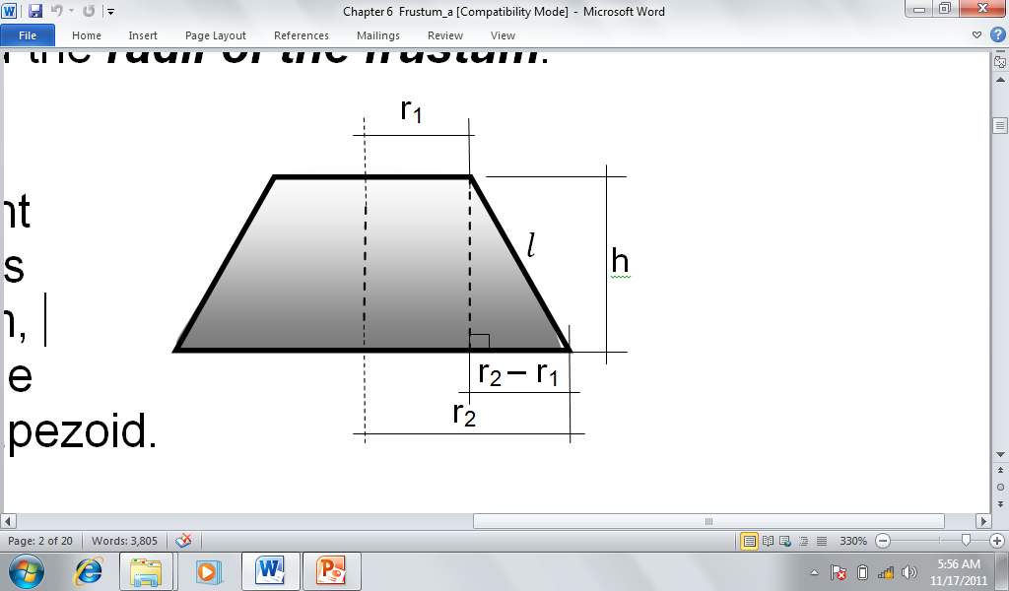
Relationship Among the Parts of the Frustum of a Cone

Slide 4
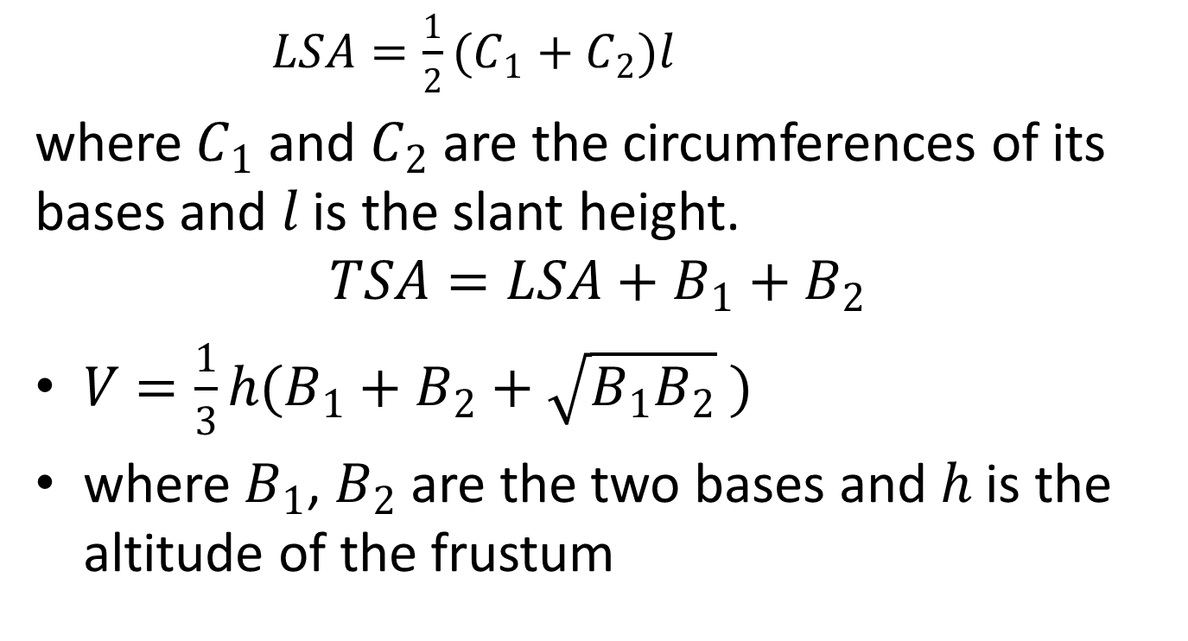
Formulas
$LSA=\frac{1}{2}(C_{1}+C_{2})l$
where $C_{1}$ and $C_{2}$ are the circumferences of its bases and $l$ is the slant height.
$$TSA=LSA+B_{1}+B_{2}$$
$V=\frac{1}{3}h(B_{1}+B_{2}+\sqrt{B_{1}B_{2}} )$
where $B_{1}$, $B_{2}$ are the two bases and $h$ is the altitude of the frustum

Slide 5
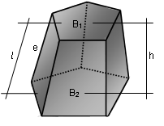
The frustum of a pyramid is the lower portion of a pyramid obtained by passing a cutting plane parallel to the base intersecting all the lateral edges. Thus, it is a polyhedron enclosed by the pyramidal surface, the base of the pyramid and the parallel plane.

Slide 6


Surface Areas
$A_{Trapezoid}=\frac{1}{2}\left(b_{1}+b_{2}\right)l.$
$LSA=\frac{1}{2}\left(P_{1}+P_{2}\right)l .$ .
$TSA=LSA+B_{1}+B_{2}$

Slide 7

Volume of Frustum of a Pyramid
$V=\frac{1}{3}h\left(B_{1}+B_{2}+\sqrt{B_{1}B_{2}} \right)$

Slide 8
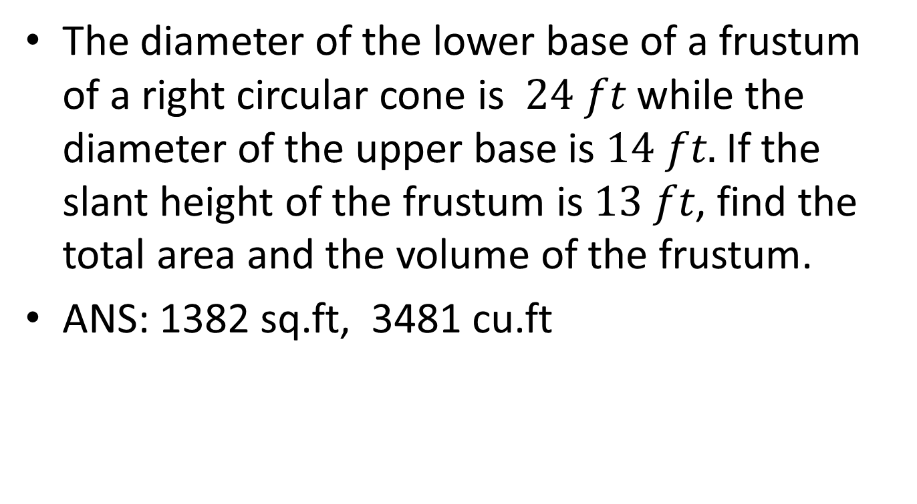
EXAMPLE 1
The diameter of the lower base of a frustum of a right circular cone is $24 ft$ while the diameter of the upper base is $14 ft.$ If the slant height of the frustum is $13 ft$, find the total area and the volume of the frustum.
ANS: 1382 sq.ft, 3481 cu.ft

Slide 9
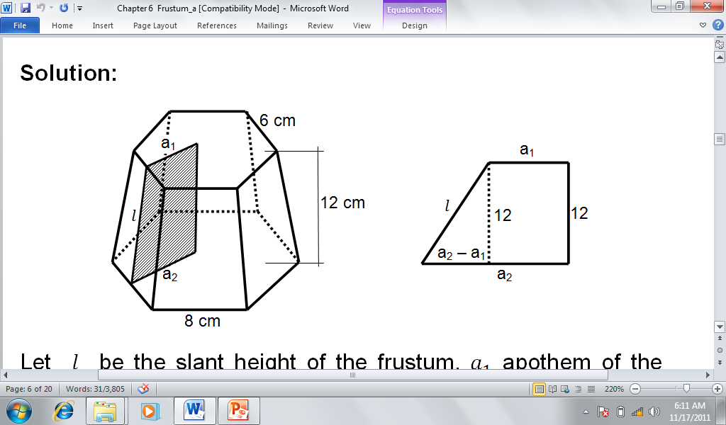

EXAMPLE 2
Find the volume and the total area of a frustum of a regular hexagonal pyramid with base edges of $6 cm$ and $8 cm$, respectively, and whose altitude is $12 cm.$
ANS:
769 sq.cm.
1538 cu.cm

Slide 10
A truncated circular cylinder, also known as cylindrical segment is the solid formed by passing a cutting plane through a circular cylinder intersecting all its elements.

Slide 11
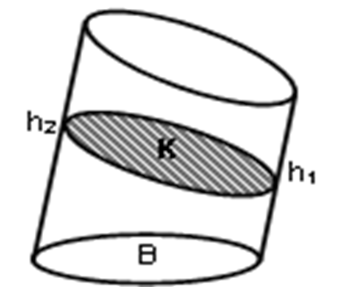
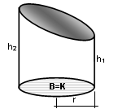

Volume of a Truncated Cylinder
$V=K\left(\frac{h_{1}+h_{2}}{2}\right).$
$V=πr^{2}\left(\frac{h_{1}+h_{2}}{2}\right).$

Slide 12
A truncated prism is a polyhedron which is a portion of a prism cut off by a plane not parallel to the base and intersecting all the lateral edges.

Slide 13
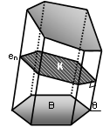

$V=KL$
where $K=Bsinθ$, $L=\frac{e_{1}+e_{2}+…+e_{n}}{n}$ and $n$ is the number of sides in its base.

Slide 14
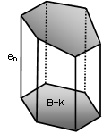

$$V=BL$$

Slide 15
A prismatoid is a polyhedron having two bases which are polygons lying in parallel planes, and lateral faces which are triangles and quadrilaterals with one side common with one base, and the opposite vertex or side common with the other base.

Slide 16
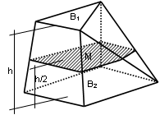
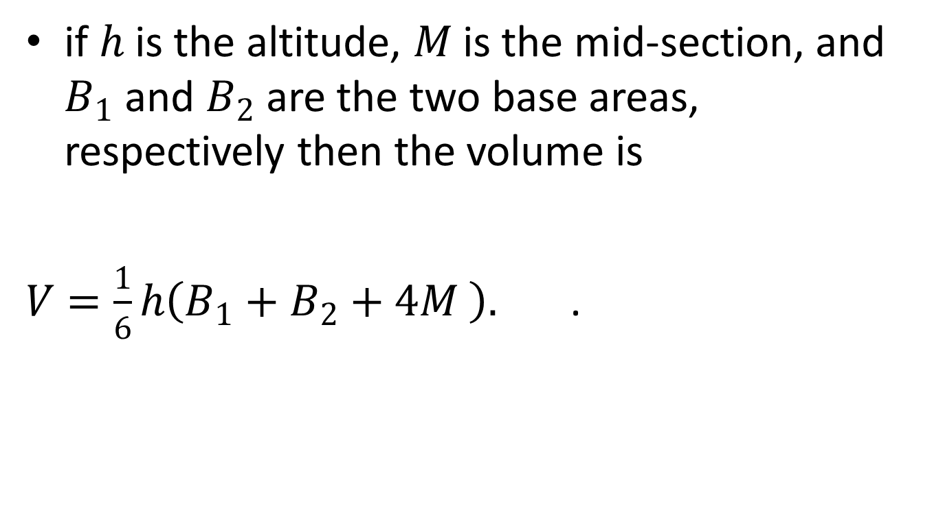
if $h$ is the altitude, $M$ is the mid-section, and $B_{1}$ and $B_{2}$ are the two base areas, respectively then the volume is
$V=\frac{1}{6}h\left(B_{1}+B_{2}+4M \right).$ .

Slide 17
A cylindrical wedge is the solid formed by passing two cutting planes through a right circular cylinder, one plane perpendicular to the axis of the cylinder and the other inclined plane intersecting the first plane through a diameter of the base.

Slide 18
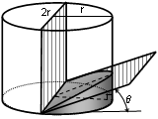

$V=\frac{2}{3}r^{3}tanθ$

Slide 19
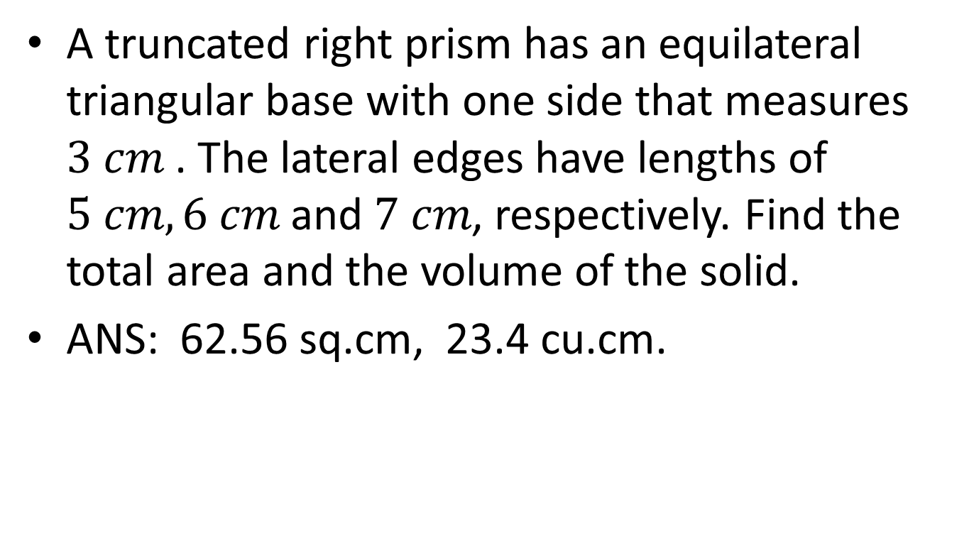
EXAMPLE 4
A truncated right prism has an equilateral triangular base with one side that measures $3 cm$ . The lateral edges have lengths of $5 cm, 6 cm$ and$7 cm$, respectively. Find the total area and the volume of the solid.
ANS: 62.56 sq.cm, 23.4 cu.cm.

Slide 20
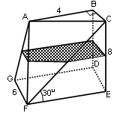
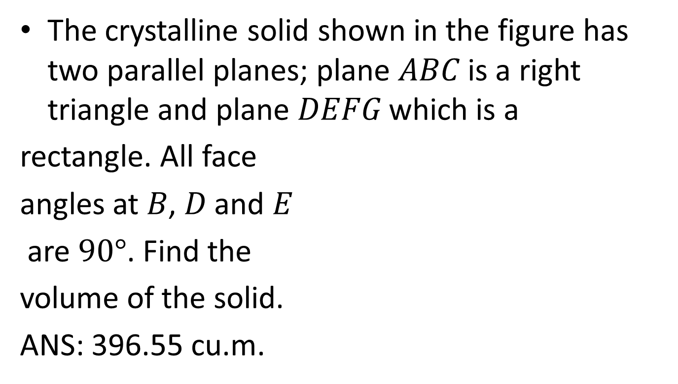
EXAMPLE 7
The crystalline solid shown in the figure has two parallel planes; plane $ABC$ is a right triangle and plane $DEFG$ which is a
rectangle. All face
angles at $B$, $D$ and $E$
are $90°$. Find the
volume of the solid.
ANS: 396.55 cu.m.

Slide 21
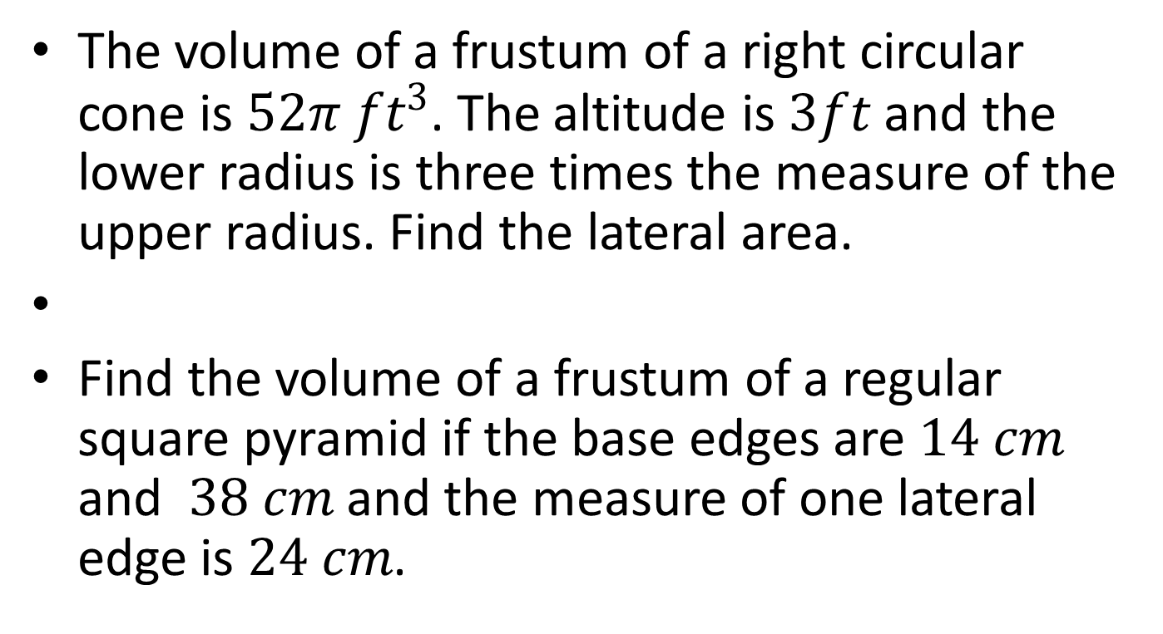
EXERCISES
The volume of a frustum of a right circular cone is $52π ft^{3}$. The altitude is $3ft$ and the lower radius is three times the measure of the upper radius. Find the lateral area.
Find the volume of a frustum of a regular square pyramid if the base edges are $14 cm$ and $38 cm$ and the measure of one lateral edge is $24 cm$.

Slide 22
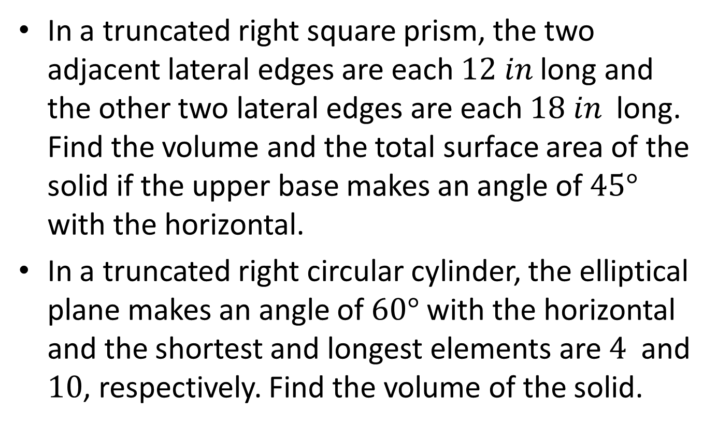
In a truncated right square prism, the two adjacent lateral edges are each $12 in$ long and the other two lateral edges are each $18 in$ long. Find the volume and the total surface area of the solid if the upper base makes an angle of $45°$ with the horizontal.
In a truncated right circular cylinder, the elliptical plane makes an angle of $60°$ with the horizontal and the shortest and longest elements are $4$ and $10$, respectively. Find the volume of the solid.

Slide 23

Find the radius of a cylindrical wedge whose volume is $36\sqrt{3}$ cubic units and whose inclined plane makes an angle of $30°$ with respect to the semi-circular plane.

Slide 24
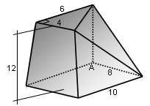
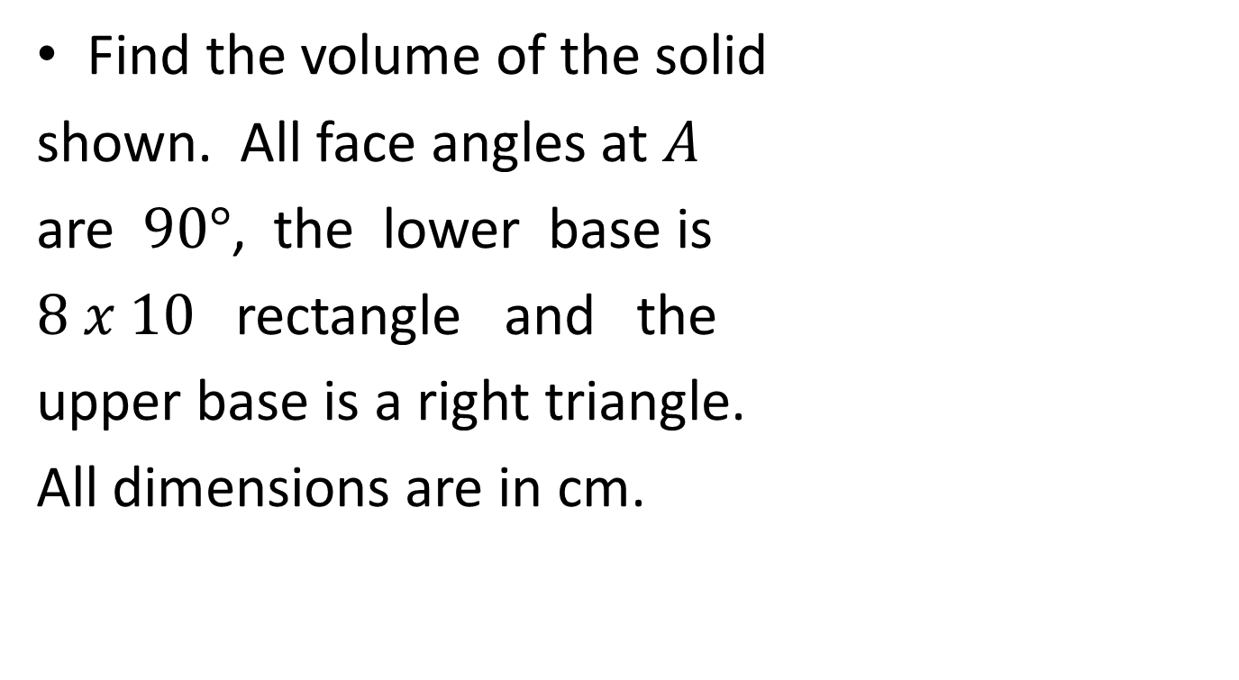
Find the volume of the solid
shown. All face angles at $A$
are $90°$, the lower base is
$8 x 10$ rectangle and the
upper base is a right triangle.
All dimensions are in cm.

Slide 25
Homework
6.1 : #’s 7, 13, 15 pp. 150-152
6.2 : #’s 1, 5, 13, 21 pp. 159-162

